Slide 1
Modeling and Data Uncertainties
Miodrag Bolic
Some material is from the presentation:
Modeling and Data Uncertainties
Sankaran Mahadevan
Vanderbilt University, Nashville, TN
NASA/NAI Summer Design Institute on Uncertainty
Hampton, VA, July 20, 2011

Slide 3
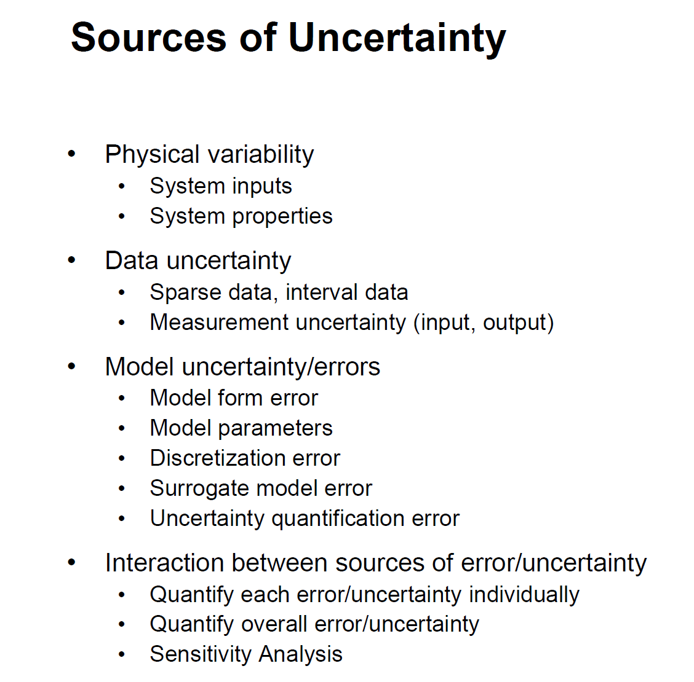

Slide 4
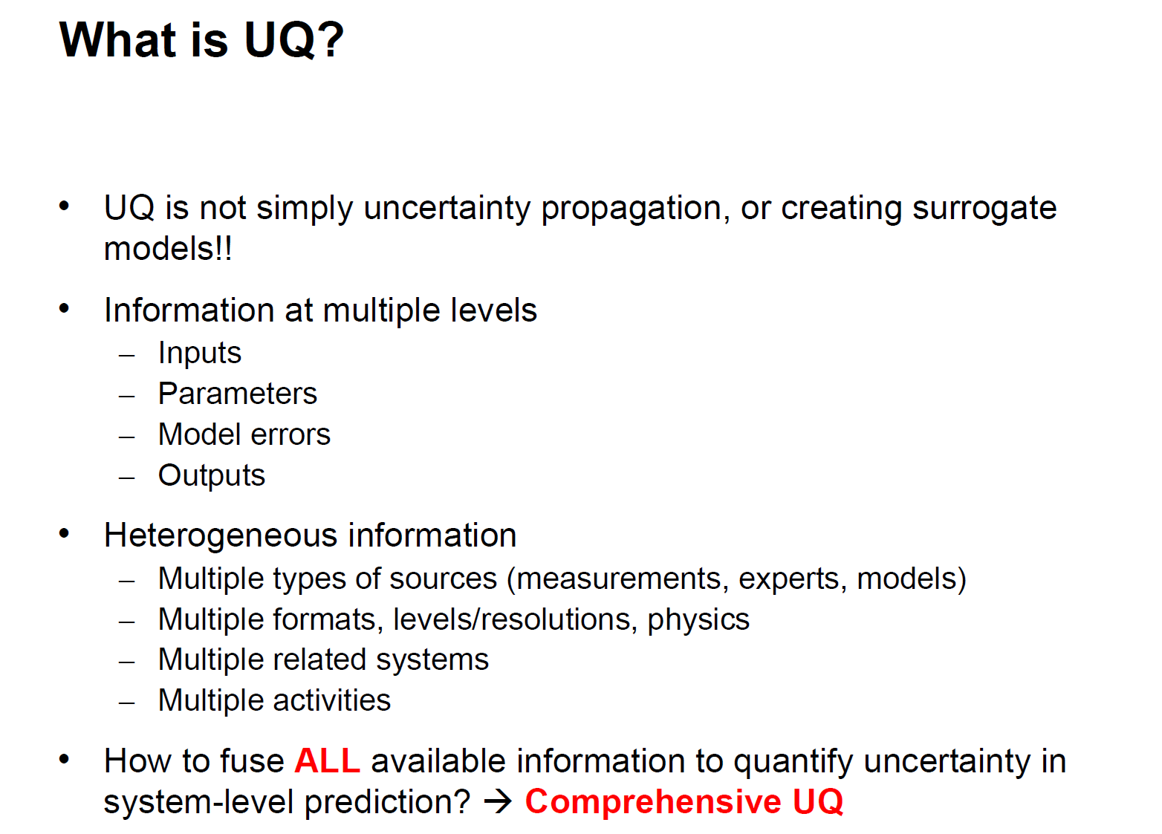

Slide 6
Some concepts that we covered
Part 1
Probability and statistics
Likelihood
Bayes theorem
MCMC simulation
Kernel density estimation
Part 2
Uncertainty propagation
Sensitivity analysis
Performance metrics
Agreement
Part 3
MCMC and probabilistic programming
Bayesian modeling
Time series
Relation to other fields
Uncertainty quantification in science
Uncertainty propagation
Sensitivity analysis
Modeling
Measurement theory
Uncertainty propagation
Error models
Agreement
Machine learning
Bayesian machine learning
Regression
Gaussian processes

Slide 7
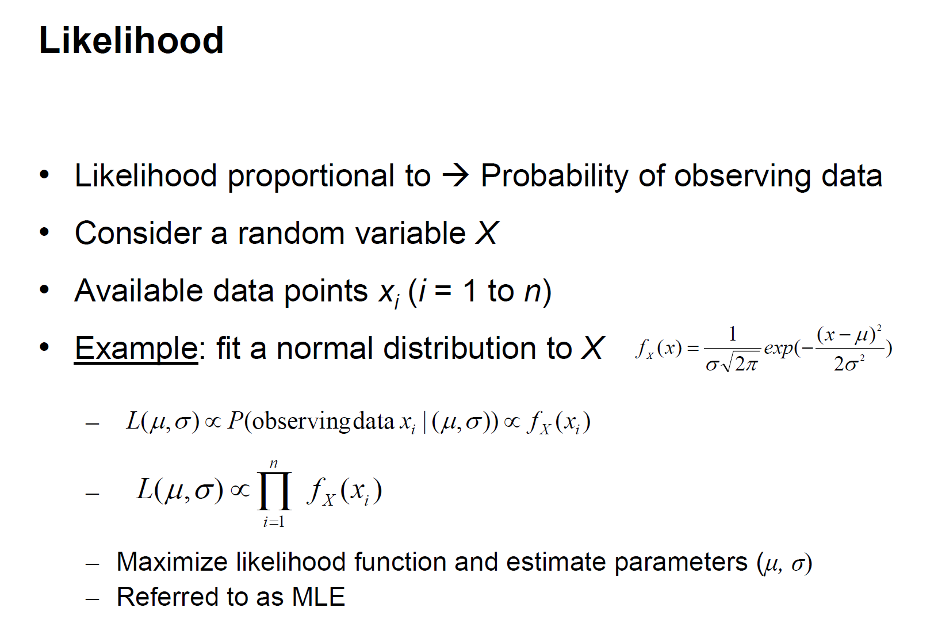

Slide 8
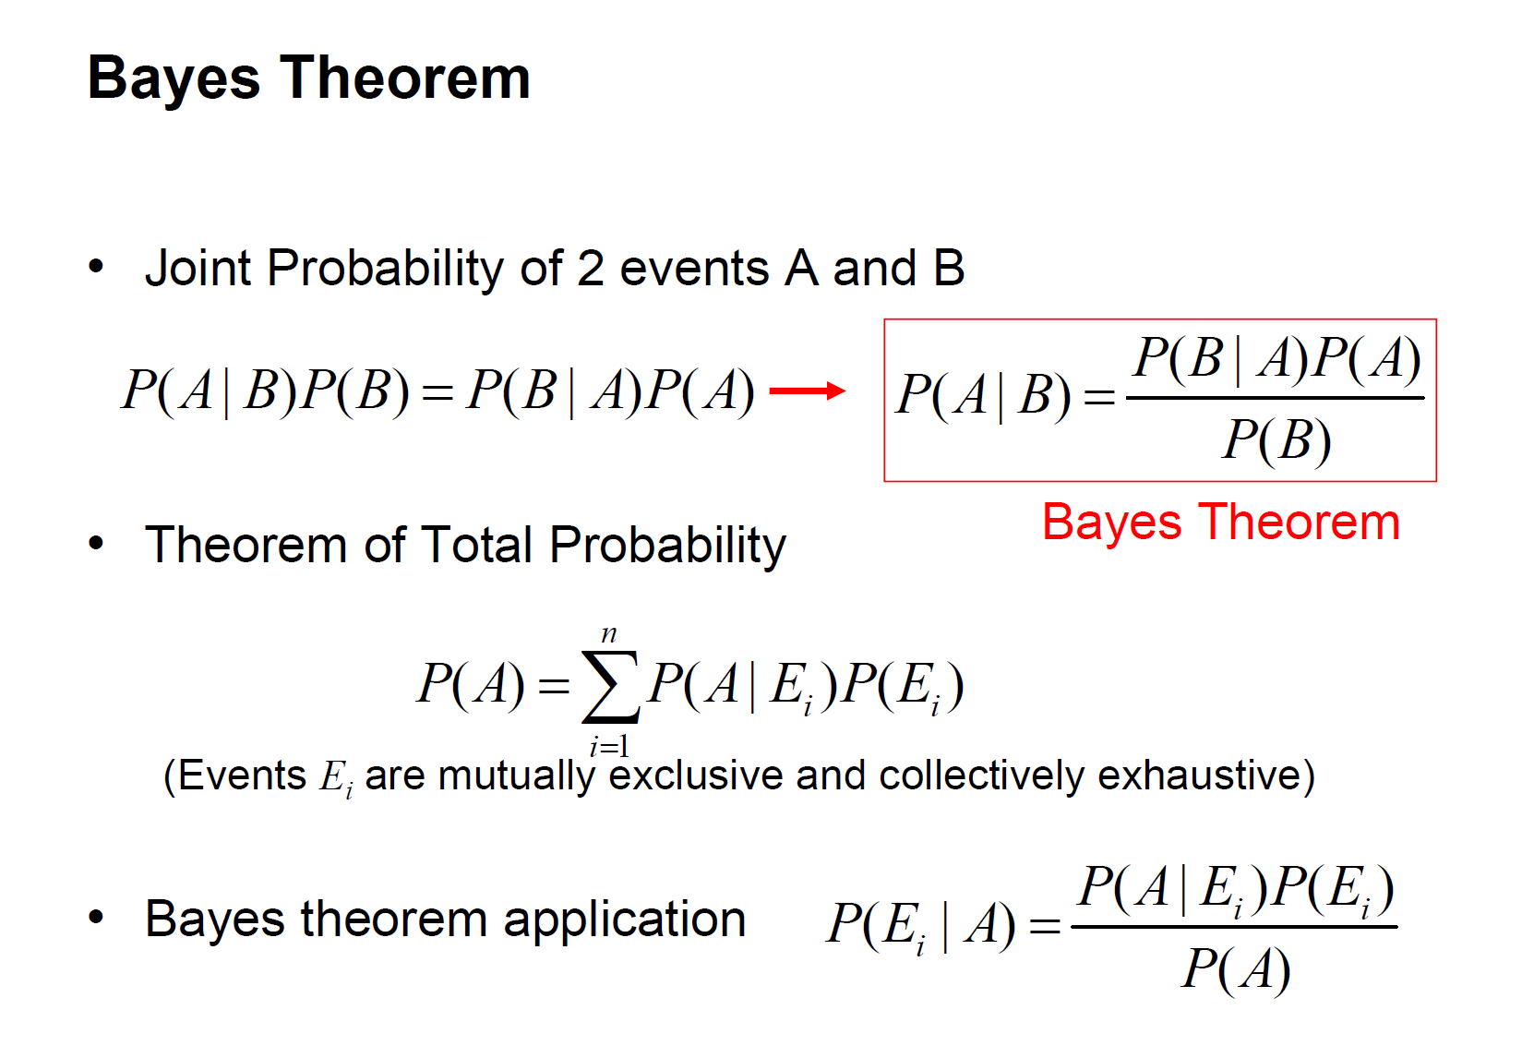

Slide 9
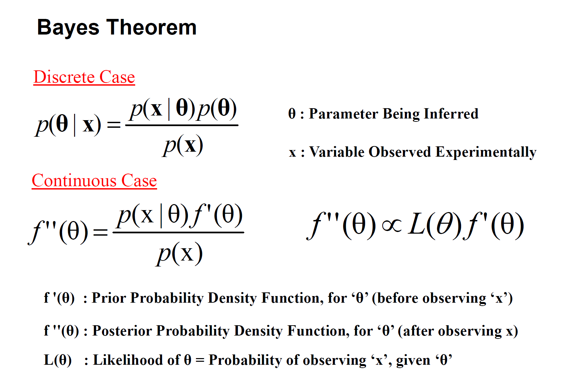

Slide 10
Estimation Theory
Point estimation
Maximum aposteriori estimation
Linear Least Mean Squared estimation
Maximum Likelihood Estimation
Performance metrics of linear regression models

Slide 11
Monte Carlo
Basic Monte Carlo method
Monte Carlo Integrals
Importance Sampling
Inverse Transform
Rejection Sampling

Slide 12

Bootstrap procedure
$X=\left(X_{1},…,X_{n}\right)$ - a sample from a distribution F
$X^{∗}=\left(X_{1}^{∗},…,X_{n}^{∗}\right)$ - a simple random sample from the data
$\hat{θ}$ is an estimator of $θ$
$θ^{∗}$ is based on $X_{i}^{∗}$
Examples:
$$\hat{θ}={\overline{X}}_{n}, θ^{∗}={\overline{X}}_{n}^{∗}$$
$$\hat{θ}=\frac{1}{n}\sum_{i=1}^{n}{{\left(X_{i}−{\overline{X}}_{n}\right)}^{2}, } θ^{∗}=\frac{1}{n}\sum_{i=1}^{n}{{\left(X_{i}^{∗}−{\overline{X}}_{n}^{∗}\right)}^{2}}$$
$\hat{θ}−θ$ behaves like $θ^{∗}−\hat{θ}$
Notes:
From presentation: Model Fitting, Bootstrap, & Model Selection by G. Jogesh Babu

Slide 13
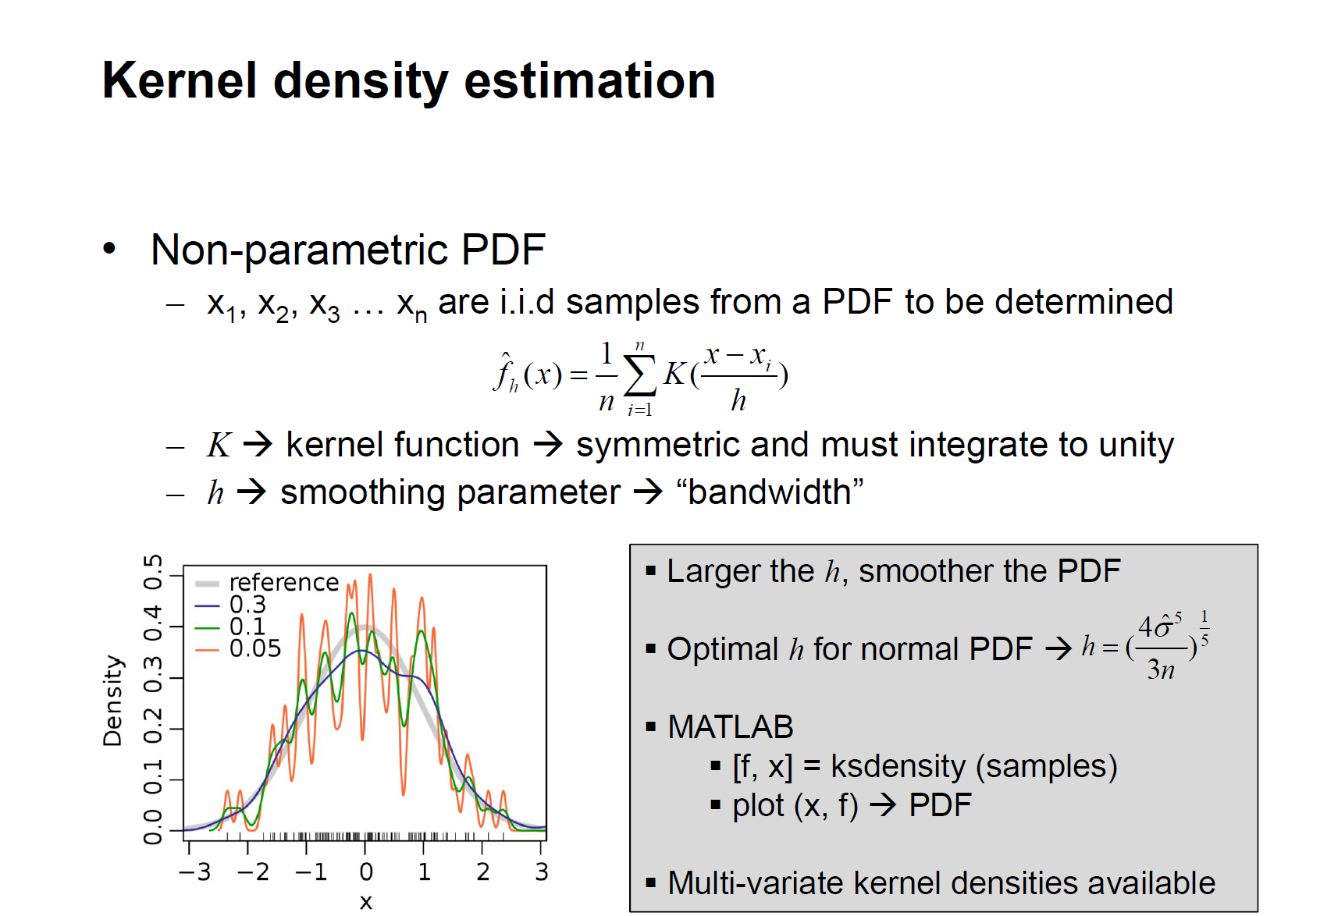

Slide 14
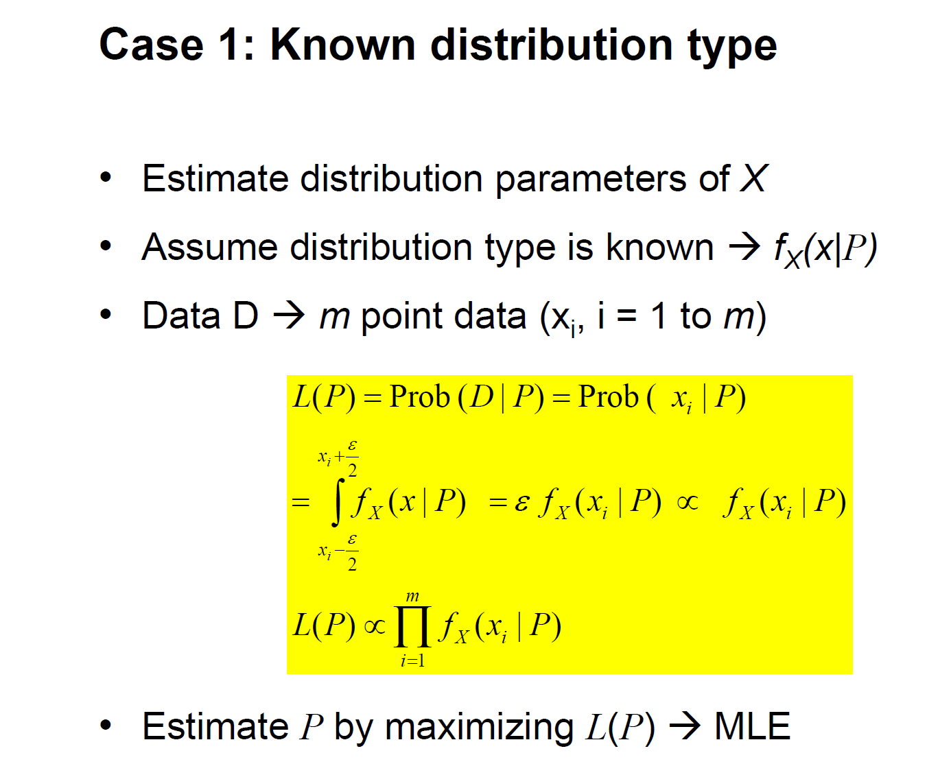
Density Estimation: Likelihood-Based Approach to Data Uncertainty

Slide 15
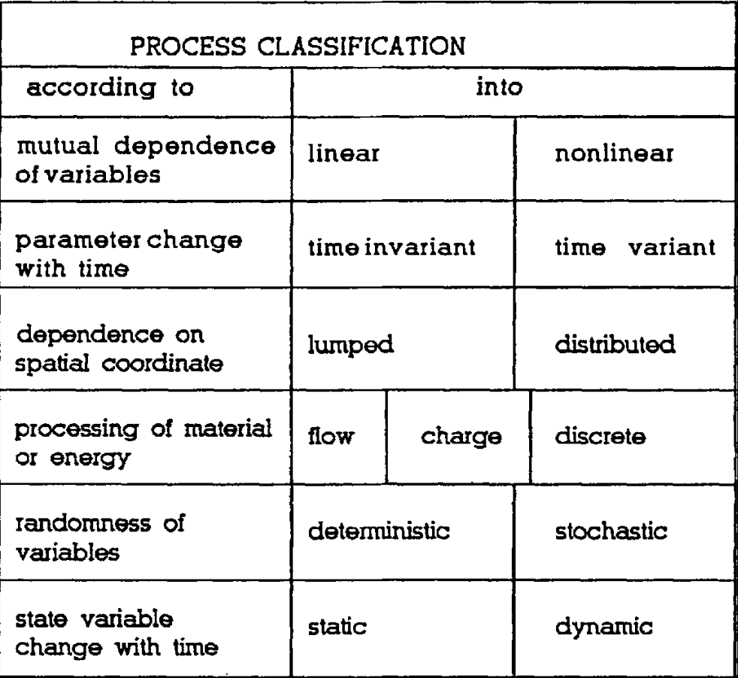
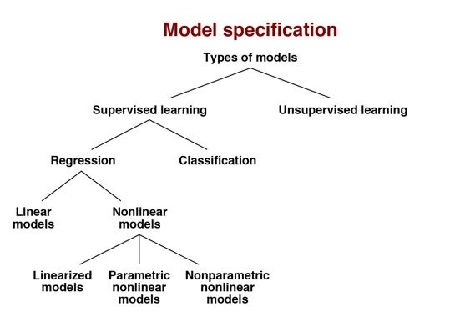
Modeling
Descriptive – data based
Explanatory - physical
V. Kecman, State-Space Models of Lumped and Distributed Systems, Springer-Verlag , 1988.

Slide 16
Uncertainty Propagation
Confidence intervals
Credible intervals
Uncertainty propagation
GUM
Perturbation methods
Monte Carlo methods
Uncertainty budget for designing systems
Uncertainty budget for risk analysis – only mentioned

Slide 17
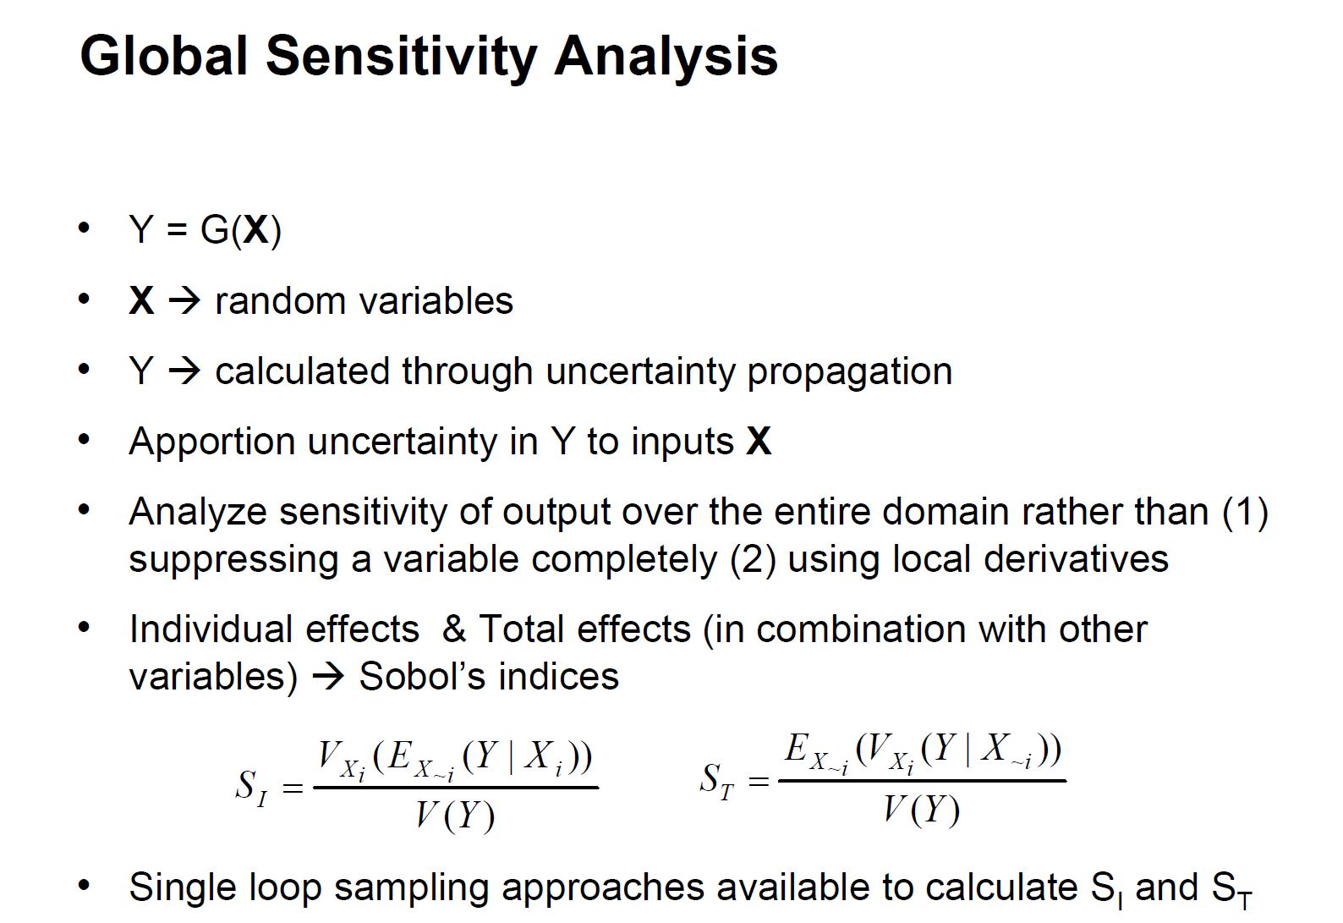

Slide 18


Error models
Performance metrics
Continuous
Classification
Accuracy = (TP+TN)/(P+N)
Precision = TP/(TP+FP)
Recall/TP rate = TP/P
FP Rate = FP/N
ROC Analysis
Correlation
Agreement (non-parametric)
Errors and error models
Paired measurements
Repeated measurements
Types of models
Mixture effect models
Bivariate normal modes
please note that they can be easily fitted using PyMC3

Slide 19
Agreement
Metrics
Continous
Mean square deviation
Concordance correlation coefficient
Total deviation index
Discrete
Cohen’s Kappa coefficient
Steps
Perform exploratory data analysis
Display data graphically using scatterplot and Bland-Altman plot
Apply appropriate error model and fit the data to the model. Check goodness of fit.
Evaluate agreement between the methods
Repeatability

Slide 20
Bayesian modeling
Parameter estimation and prediction
MCMC and divergence properties
PyMC3
Regression
Linear
Logistic
Mixture models
Hierarchical models
Model selection and performance evaluation
Gaussian processes

Slide 21
Time series
AR and ARMA processes
State space models
Bayesian filtering
Kalman filter
Particle filter
Sensor fusion

Slide 22
Measurement theory – Part 1
Lec 3 – Bayes, Gaussian
Examples of computing the SNR for A/D converter
Communication example problem
Standard errors
Lec 4 – Estimators
Repeated measurements
Lec 5 - Bootstrap
Quantifying confidence intervals using bootstap
Lec 6 – Density estimation
Quantifying uncertainties at the input

Slide 23
Measurement theory – Part 2
Uncertainty propagation
GUM
Uncertainty budget
Sensor selection based on the desired error
Error models
Paired and repeated measurements

Slide 24
Measurement theory – Part 3
Model Calibration – Parameter estimation
Bayesian or frequentist
Model validation
Bayes factors
Model selection
Bayesian metrics for model selection
Time series models

